Slide 1
FPGA-Based SoC Platform for Prototyping and Evaluation
Jonathan Ekman, Brenden Moran
Advisor : Dr. Reza Khani

Slide 2



About Us
Students
Advisor
Jonathan Ekman
Cupertino, CA
Electrical Engineering Major
Project Manager Spring Semester
Brenden Moran
Paradise, CA
Computer Engineering Major
Assistant to the Project Manager
Dr. Reza Khani
Assistant Professor
EECE Department, CSU Chico
Notes:
Intro to who we are slide, same as before, nothing has changed

Slide 3
Agenda
Background and Design Motivation
Project Goals and Metrics
Design Choices
Implementation
Final Design Overview
Testing and Verification
Conclusions and Future Improvements
Notes:
Agenda, what we are going to cover in our 12 minutes of time

Slide 4
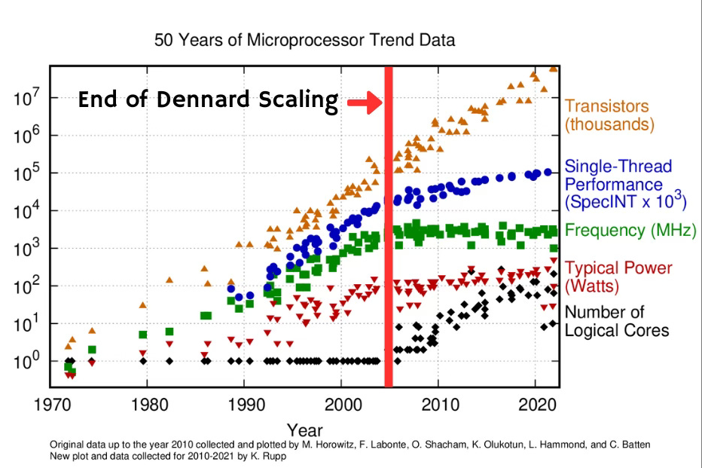
Background
The Problem
Traditional Performance gains have plateaued
Moore’s Law
Dennard Scaling
Engineers are focusing more on specialized SoC and multi-core designs
Need a platform that enables testing for these custom designs
Solution
Build a configurable multi-core analysis platform
Measures latency, bandwidth, and resources used
Notes:
Background, at most 1 min. Very brief explanation about the motivation behind our design

Slide 5
Project Goals
A highly configurable FPGA project SoC built for academia
Multicore capabilities
DDR Ram access
I/O ports
Custom Accelerators
Embedded code to utilize all components as example
Notes:
What our project is and the types of measurments we can get from this design like what we should expect as our final product and how we can measure that
Maybe be multiple slides of:
We want our project to do this
This is how we are going to achieve this
These are the types of measurments we can do to confirm the workings of our design
This is why we need a proof of concept with our accelerator

Slide 6

metrics
CPU performance
Clock cycles for an algorithm
Cache performance
System Performance
Bandwidth, latency in data W/R
Design performance
Max allowable clock, FPGA space usage
Notes:
Go in depth about accelerator logic and the ideas behind it
Why we chose matrix multiplication (AI and whatnot)
The logic behind our accelerator
How it works, high-level no actual code here

Slide 7

Design choices
FPGA Suite
AMD or Intel tools and FPGAs
AMD was chosen as the tools are superior
Accelerator
Matrix multiplication was chosen due to its practical nature
Systolic array method was used because it is superior
Performs multiplication faster using parallel compute
Direct memory access
Chosen due to the inconvenience and resource usage of loading data
Vitis
Chose number identification as a simple and interesting usage of accelerator
Notes:
How we create our project, the kind of components that will give us the best option for our design
We already talked about the accelerator so now its what system do we want this to be apart of, talk aqbout the components we already chose from last semester but now include what makes them better for this design as well
Microblaze has no on chip multiplier circuit
Very basic fpga board design

Slide 8
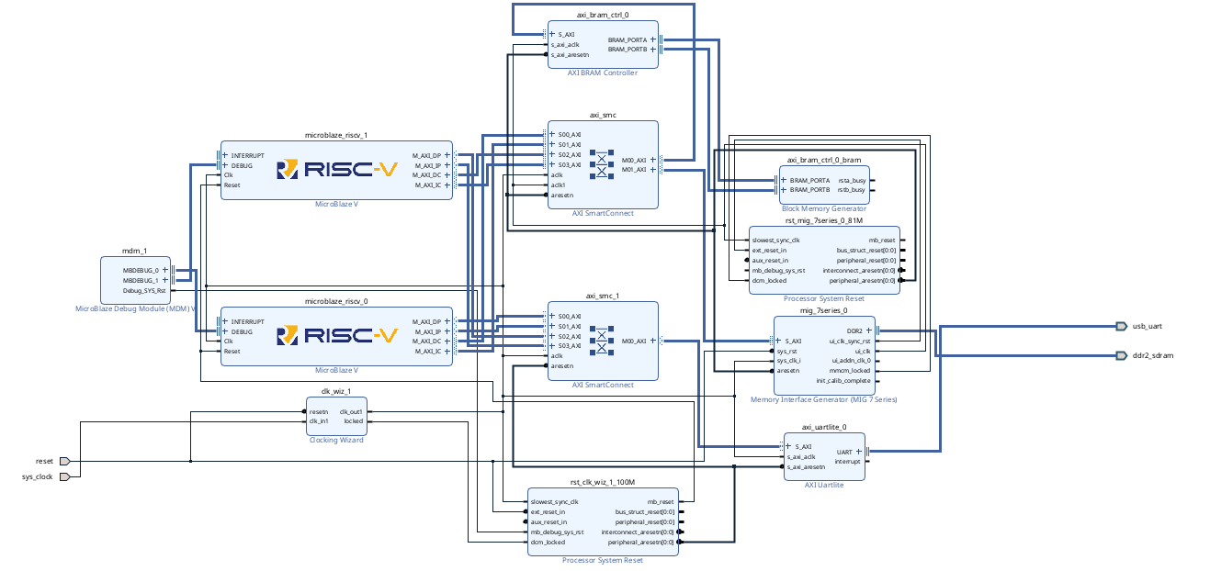
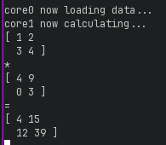
MULTICORE
The connection of 2+ cores
Cores must communicate
Issues
Lack of Cache Coherency
Solved by manually managing cache
Cache coherency is available for more advanced FPGAs
Core identification and Reset vector
Each core has unique machine thread id (MhartId)
Each core has unique reset vector
Without unique vector special measures must be taken
Tested with two core matrix multiplication Result in minicom -->
Test was successful

Slide 9

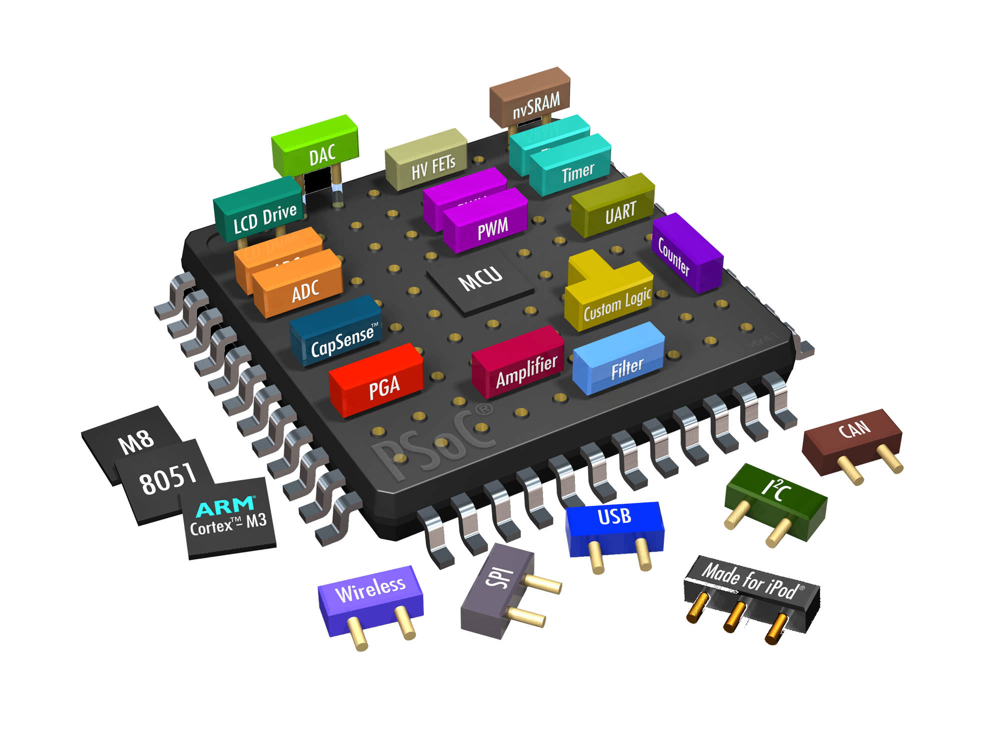
Accelerator
Multicore Design Worked Well However :
MicroBlaze V is free to use but logic is not open source ☹
Need access to its internal pipeline stages
Takes up a large number of resources ☹
Has multiple use cases ☺
Accelerator
Customizable to our design ☺
Specialized for our specific use case (matrix multiplication) ☺
Takes up much smaller number of resources ☺
Has only one use case ☹
Can use direct memory access ☺
Much faster ☺

Slide 10
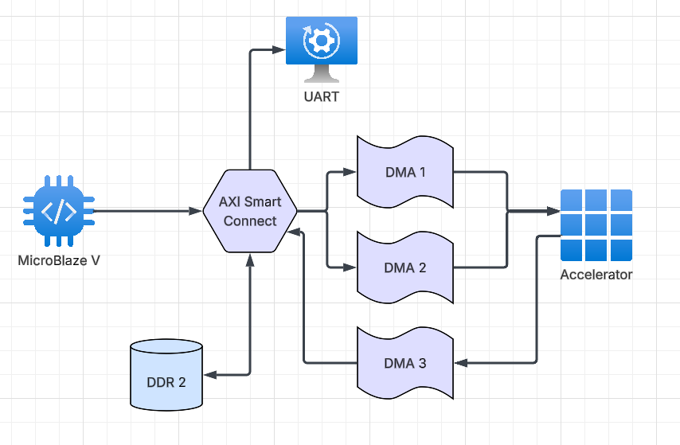
Block Diagram: Simplified
MicroBlaze V
Main processor running the code
Smart Connect
Communication to all components through AXI
DMAs
Stream input/output matrices to our accelerator.
DDR 2
Main memory, storing all data.
Notes:
Our block diagram – simple, what our simple diagram looks like for testing and measurements

Slide 11
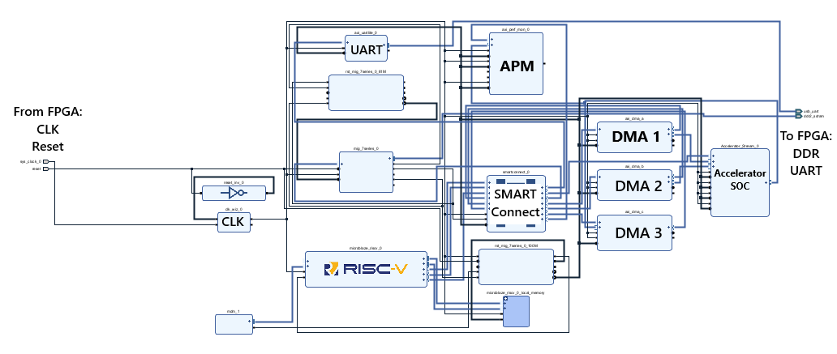
Detailed Block Diagram
Notes:
Maybe detailed block diagram, this should be a what we started with and what we have now kind of thing
Go into the connections of each thing independently for more detail on how the communicate
Talk about the axi bus
Mention the smart connect being the home for all components to communicate with preset addresses
Speak on the matrix multiplication module and how we had to create it as a custom IP with AXI lite and stream connections

Slide 12

Testing
What metrics do we want to test?
Latency (see if accelerator improves latency)
Bandwidth
Area used on chip/resources used
BONUS
Cache misses/hits
What kind of test we want
Algorithm that uses matrix multiplication heavily to compare using the accelerator with not using it
Alter this algorithm to use the APM to measure bandwidth of the accelerator's output
Vivado Design Suite does this for us!
Notes:
Testing
What values do we want to test to see
How are we going to test it (what algorithm we are going to use and how our accelerator works with it)
Brief overview of algorithm like a flowchart or something, This is not the main thing we want to show, this code was taken from online just modified to work with our custom hardware so make that apparent
What the outputs are and what each of them mean

Slide 13
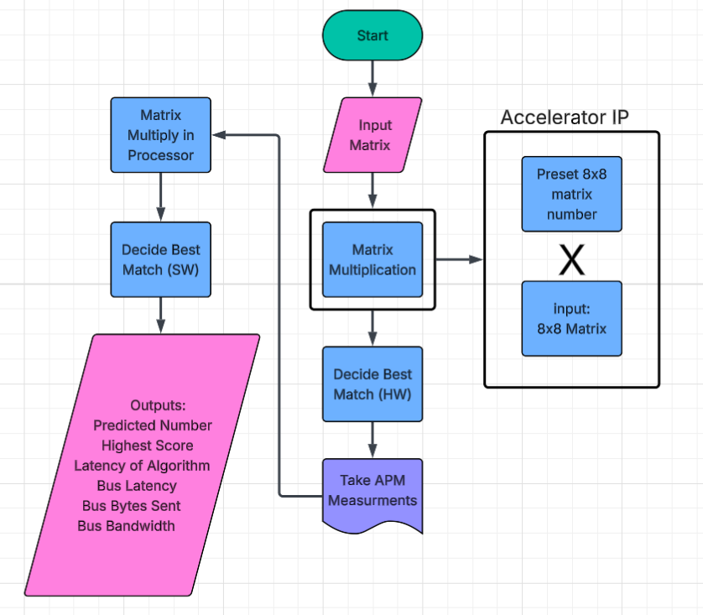
Testing Algorithm
Sudo number identification using matrix multiplication
Similar to how neural networks identify images based on weighted entries
Takes in an input matrix representing a number
Multiplies it across 10 preset matrices being numbers 0-9
Sums the diagonals (trace) of each output matrix to find best match
This is matrix multiplication heavy (10 total runs)
Many similar algorithms can be found online

Slide 14
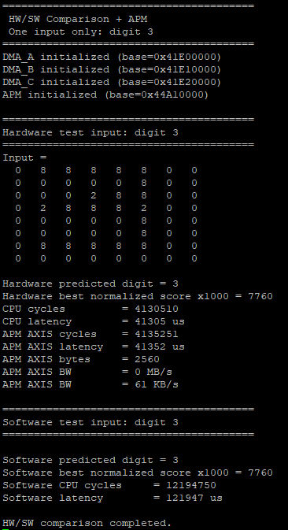
Results
Latency
Using accelerator: 41 ms
Not using accelerator: 122 ms
~3x improvement
Bandwidth
61 kB/s
Resources Used
35,000 Slice LUTs (lookup tables)
1/2 of total LUTs on board
30,000 Slice Registers
1/4 of total registers on board
13.5 Block RAM Tile
1/10 of total block RAM on board
Max Frequency
117MHz fast for FPGA softcore
Notes:
Conclusions gathered from the test and metrics gained.
Where this can be used in the future (others can take our design and make it better (pipeline it, make it parallel, instantiate more to run all in parallel) or they can test their own (import their own custom IP to test metrics))

Slide 15
Conclusions
Goal
Configurable multi-core analysis platform.
Customizable with unique SoC
Measurable metrics
Latency
Bandwidth
Resources Used
What We Achieved
FPGA-based prototyping platform used for analysis
Custom SoC accelerator
Open-source GitHub for others to use our design and make their own
Measurable metrics
Latency
Bandwidth
Resources Used
Future Improvements:
Add more accelerators
Improve parallelism
Pipeline the accelerator
Improve accelerator logic

Slide 16
References
[1] “Moore’s law: The number of transistors per microprocessor,” Our World in Data. [Online]. Available: https://ourworldindata.org/grapher/transistors-per-microprocessor. [Accessed: Sep. 30, 2025].
[2] V. Sekar, “How Dennard scaling allowed transistors to shrink,” Vik’s Newsletter, Jan. 12, 2025. [Online]. Available: https://www.viksnewsletter.com/p/how-dennard-scaling-actually-works. [Accessed: Sep. 30, 2025].
[3] AMD, MicroBlaze V Processor Reference Guide, UG1629. [Online]. Available: https://docs.amd.com/r/en-US/ug1629-microblaze-v-user-guide/Introduction. [Accessed: Nov. 30, 2025].
[4] AMD, “MicroBlaze V RISC-V processor overview,” Aug. 7, 2025. [Online]. Available: https://www.amd.com/en/products/software/adaptive-socs-and-fpgas/microblaze-v.html. [Accessed: Nov. 30, 2025].
[5] Arm Ltd., “Multi-core processors,” Arm Developer Documentation, 2025. [Online]. Available: https://developer.arm.com/documentation/den0013/0400/Multi-core-processors. [Accessed: Nov. 30, 2025].
[6] RISC-V International, “Ratified RISC-V specifications.” [Online]. Available: https://riscv.org/specifications/ratified/. [Accessed: Nov. 30, 2025].
[7] D. S. Roy, “Systolic matrix multiplier,” Digital System Design, Jun. 12, 2020. [Online]. Available: https://digitalsystemdesign.in/systolic-matrix-multiplier/. [Accessed: Dec. 18, 2025].
[8] IEEE Standards Association, IEEE Standard for SystemVerilog—Unified Hardware Design, Specification, and Verification Language, IEEE Std 1800-2017. Piscataway, NJ, USA: IEEE, 2017.
[9] National Institute of Standards and Technology (NIST), Framework for Improving Critical Infrastructure Cybersecurity, Version 1.1. Gaithersburg, MD, USA: NIST, 2018.
[10] N. Dave, K. Fleming, M. King, M. Pellauer, and M. Vijayaraghavan, “Hardware acceleration of matrix multiplication on a Xilinx FPGA,” in Proc. IEEE Int. Workshop on Memory System Performance and Correctness (MEMPOD), May 2007, pp. 97–100, doi: 10.1109/MEMCOD.2007.371239.
[11] A. Peiris, “Digital design of systolic array architecture for matrix multiplication,” Ashan’s Blog, Aug. 1, 2015. [Online]. Available: https://ashanpeiris.blogspot.com/2015/08/digital-design-of-systolic-array.html. [Accessed: Dec. 18, 2025].
Notes:
References

Slide 17
Thank You!
Any Questions?

Slide 18
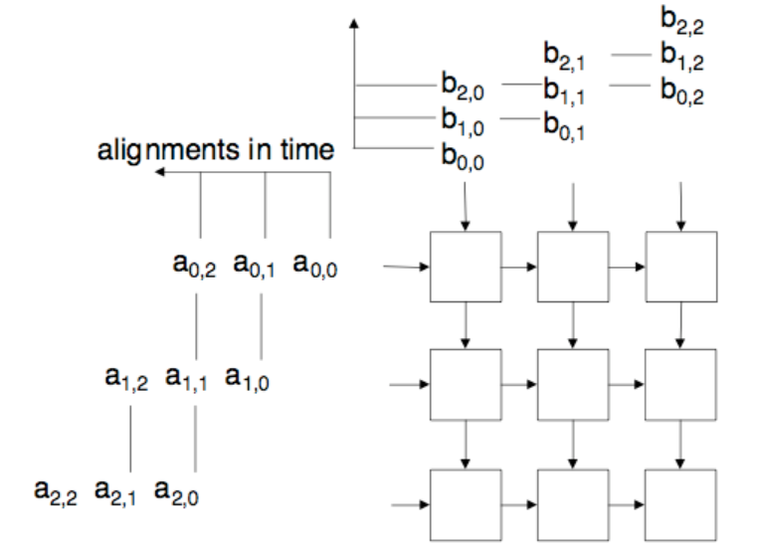
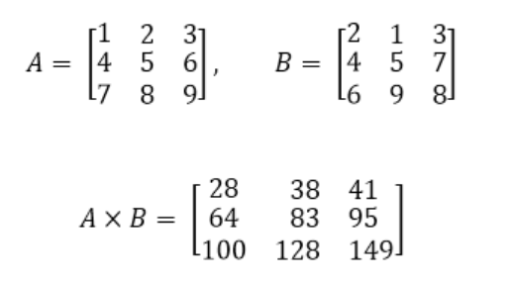
Systolic Array Accelerator
1*2
+ 2*4
+ 3*6
1*1
+ 2*5
+ 3*9
4*2
+ 5*4
+ 6*6
Notes:
Backup slides in case we get questions about it

